Slide 1
Final Software Project
Online Course Enrollment System
Raul Machuca
CST 499: Capstone for Computer Software Technology
Charmelia Butler
June 30, 2025
Notes:
Hello everyone, my name is Raul Machuca. Today I'll be presenting my capstone project for CST 499, which is the Online Course Enrollment System. This project integrates all the concepts I've learned throughout my software technology program.

Slide 2
Introduction
Full SDLC web application
Secure and user-friendly
PHP, MySQL, HTML, CSS, Bootstrap
UML for design and testing.
Notes:
This project is a complete software development lifecycle application. It’s a secure, user-friendly online system that allows students to register, log in, browse available courses, enroll, and manage their course schedule. It was developed using PHP, MySQL, HTML, CSS, Bootstrap, and UML modeling.

Slide 3
SRS Document Overview
Define functional and nonfunctional requirements
Registration, login, course listing, and enrollment
Security, usability, and maintainability
Blueprint guiding the entire project
Notes:
In my Software Requirements Specification, I outlined both functional and nonfunctional requirements. Functionally, the system allows registration, authentication, course listing, enrollment with seat checks, and partial waitlisting. Nonfunctional requirements focused on secure password handling, responsive performance, and a maintainable, modular architecture. This SRS served as the blueprint for my entire project.

Slide 4
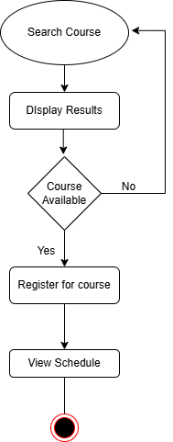
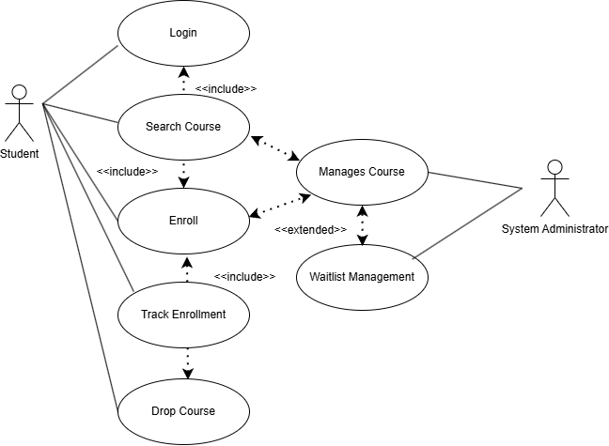
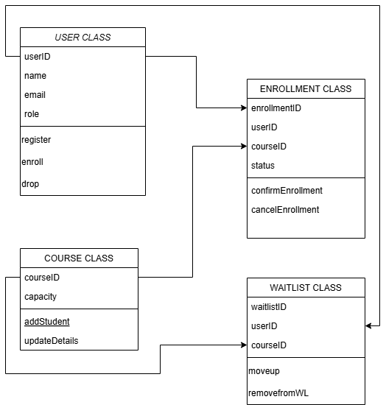
UML Design Model
Use Case: Student interactions
Class Diagram: System Structure
Sequence and Activity
Notes:
For the design, I created several UML diagrams. The use case diagram shows student interactions with the system, the class diagram defines the system's core structure, the sequence diagram maps out the enrollment process flow, the activity diagram captures decision points during enrollment, and the state diagram shows the lifecycle of an enrollment from pending to enrolled or waitlisted. This modeling helped ensure a clear, testable design.

Slide 5
Landing, Login, Registration Pages
Landing page directs to login/register
Login: verifies credentials, starts session
Registration: Hashed passwords, unique ID creation
Responsive design with Bootstrap
Notes:
The user interface starts with a simple landing page built using Bootstrap that directs users to either log in or register. The login page securely authenticates student credentials and starts a session, while the registration page collects details, hashes passwords, and ensures each email is unique. This makes the system secure and user-friendly on both desktop and mobile devices.

Slide 6
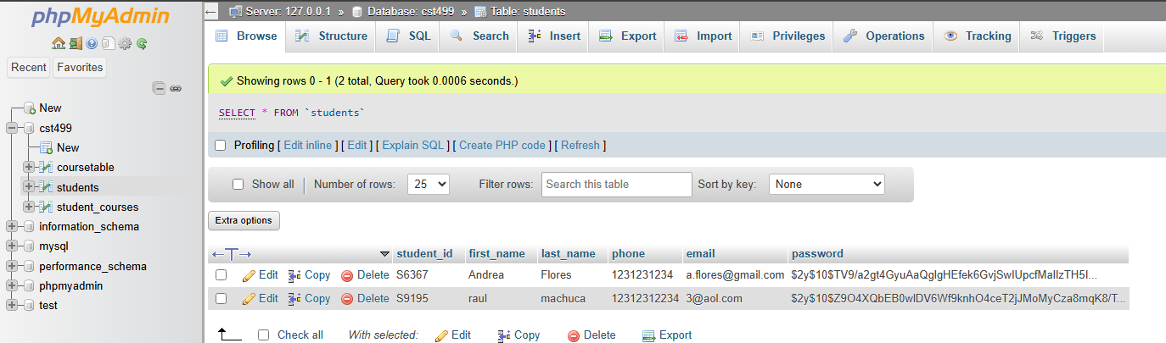
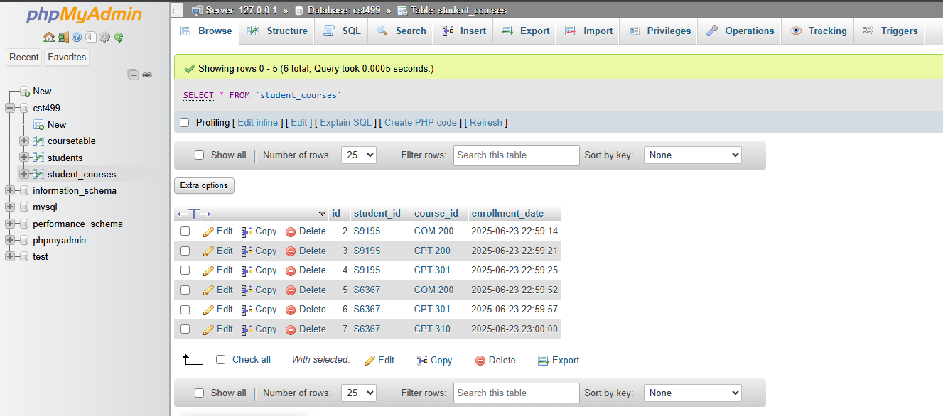
MySQL Database & Class Registration
Tables: students, coursetable, student_courses
Many to many enrollment
Seat tracking and foreign keys
Supports scalable relationships
Notes:
On the backend, I designed a relational database with three main tables: students, coursetable, and student_courses. This supports a scalable many-to-many relationship, allowing students to enroll in multiple courses and courses to have multiple students. It also includes seat tracking and uses foreign keys to enforce data integrity.

Slide 7
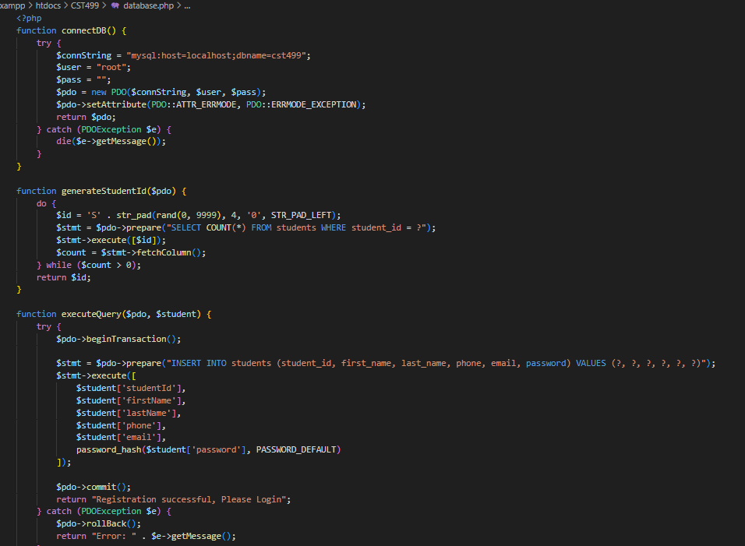
PHP Code Highlights
Secure PDO and prepare statements
Generates unique IDs and hashed passwords
Scripts for courses, enrollment, and schedules
Modular, maintainable, well-documented
Notes:
The PHP backend uses a secure PDO connection for database interactions and prepared statements to prevent SQL injection. Registration generates unique student IDs and hashes passwords. The login verifies those hashes. Additional scripts handle course viewing, enrollment, seat updates, and schedule displays. I kept the code modular and well-commented to support maintainability and future scaling.

Slide 8
SRS vs PHP Implementation
SRS Requirement | Description from SRS | Implemented in PHP / MySQL
REQ-1: Registration | Allow user registration with unique ID & password | registration.php uses generateStudentId(), executeQuery() to insert students. Passwords hashed with password_hash().
REQ-2: Unique ID validation | Ensure no duplicate IDs or emails | registration.php checks email uniqueness in DB; students table uses UNIQUE on email.
REQ-3: Store user profile | Save student name, phone, email, password | Stored in students table via database.php functions.
REQ-4: Login authentication | Login using registered credentials | login.php verifies user with password_verify() and starts session.
REQ-5: Course listing | Display courses by semester | view_courses.php queries coursetable and displays in table format.
REQ-6: Enrollment with seat checks | Enroll only if seats are available | enrollment.php checks seat_available before inserting to student_courses.
REQ-7: Waitlisting when full | Add to waitlist if course is full | Supported partially: currently rejects if full; future enhancement documented to add waitlist logic.
REQ-8: Notify on cancellation | Notify next waitlisted student when seat opens | Documented in SRS for future, placeholder in system design. Not implemented in this version.
Nonfunctional: Security | Password hashing, prevent SQL injection | password_hash() + password_verify() in login/registration; all DB operations use PDO prepared statements.
Nonfunctional: Maintainability | Modular code, clear comments, hosted on GitHub | Functions like connectDB() in database.php, consistent commenting.
Nonfunctional: Performance | Load response under 2 sec for typical usage | Meets on XAMPP local test (not formally load tested).
Notes:
Here you can see how each requirement in my SRS was implemented in code. Registration, login, course listing, enrollment, and security measures all directly map to my PHP files and database schema. This traceability shows the project stays aligned with its original specifications.

Slide 9
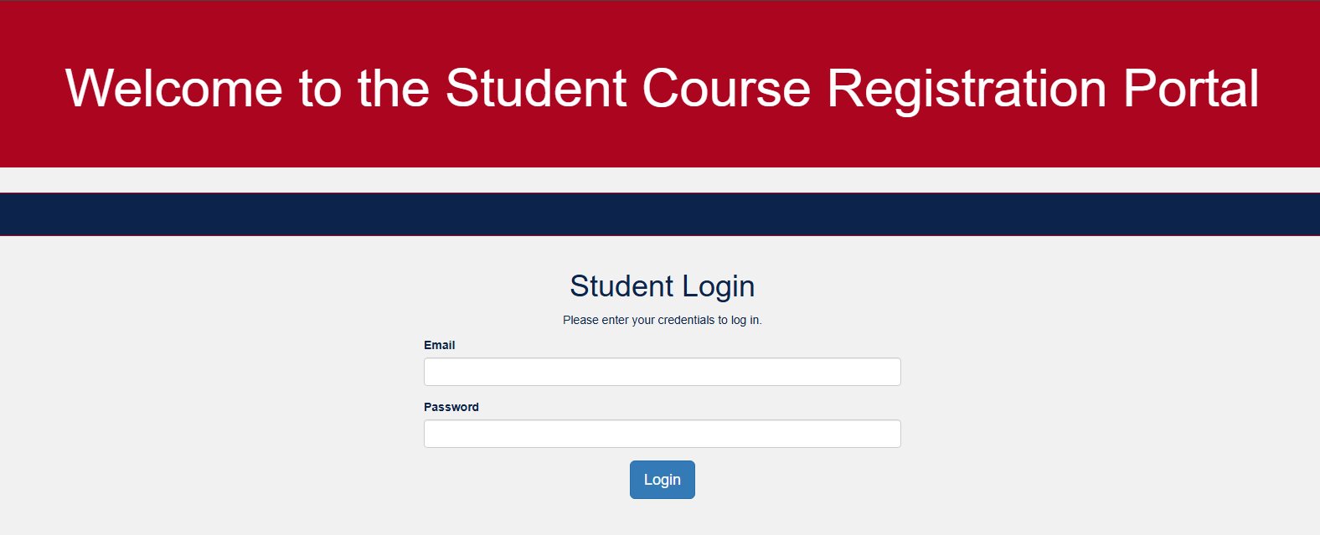
Lessons Learned & Next Steps
Strengthened secure PHP and database design
Future improvements:
Automated testing tools
Admin dashboard
Notes:
This project really helped me advance my skills in secure PHP programming, relational database modeling, and using UML diagrams to drive both planning and testing. I also learned a lot about tying requirements directly to implementation through traceability.
Looking ahead, I’d like to expand this system by adding automated waitlist notifications to improve the student experience, building an admin dashboard so administrators can manage courses more easily, and integrating automated testing tools to make sure updates don’t break existing functionality.

Slide 10
References
Tsui, F., Karam, O., & Bernal, B. (2018). Essentials of software engineering (4th ed.). Jones & Bartlett Learning.
Connolly, R., & Hoar, R. (2022). Fundamentals of web development (3rd ed.). Pearson.
PHP Manual. (n.d.). PHP: Manual. https://www.php.net/manual/en/
Rani, S., & Rana, M. (2018). Design of software testing model based on UML class and activity diagram. International Journal of Engineering and Advanced Technology, 7(6), 8–15. https://doi.org/10.21833/ijaas.2021.11.014
Notes:
I used a combination of textbooks, official documentation, and online tutorials, including resources from Sommerville, Tsui, the PHP Manual, Bootstrap Docs, and TraversyMedia tutorials.

Slide 11

Thank You
Notes:
Thank you very much for watching my presentation. I'm happy to answer any questions you might have.

